Slide 1
Installing Go To Meeting
Go to www.gotomeeting.com and click the Login at top right.
On the Secure Login screen locate link that reads: Need to Need to re-install our software?
On the Installing Our Software screen click:
When prompted click
The Go To Meeting icon should appear in your system tray.
Launch Software
Run
Notes:
1

Slide 2
Scheduling a Meeting
Important ~ Right click over icon in your system tray
Select Schedule Meeting
Enter one of the following based on your team:
West: amber.madrigal.osv@fedex.com /Amberm01
Central: leland.mangrum.osv@fedex.com / Fedex123
East: jean.peters.osv@fedex.com /Clay1998
Click: Schedule Meeting
Notes:
2
Log into Go To Meeting

Slide 3
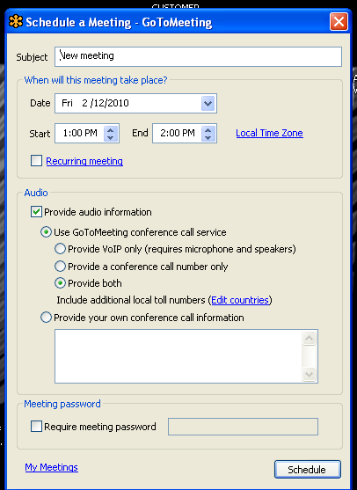
Schedule a Meeting
Subject: Company name / PID no.
Date: Select appointment date
Start: Select appointment start time
End: Select End time based on training needs/size of group
Audio: Keep default settings
Meeting password: Leave blank
Click: Schedule
Note: You will receive notification that your meeting has been scheduled. A Microsoft Outlook meeting reminder will be generated and give you the option of inviting attendees via Outlook – close all windows. Open Fedex email & compose email to your customer. Follow procedure as outlined in Invite Attendees to Scheduled Meeting.
Notes:
3

Slide 4
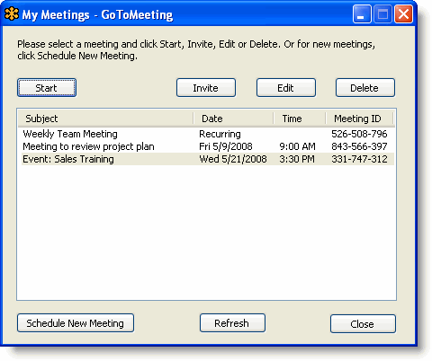
Invite attendees to a Scheduled Meeting
Invite Attendees to a Scheduled Meeting
An organizer can invite attendees to a scheduled meeting at any time prior to the start of the meeting.
Note: For information on how to invite attendees to a meeting already in progress, please see the Invite Attendees During a Meeting section.
To invite attendees to a scheduled meeting
1. Right-click the icon in the PC system tray - select My Meetings.
2. If prompted - Enter your Email and Password in the Login window, and click Log In.
3. On the My Meetings window, select the meeting you want to invite attendees to by clicking the name of the meeting in the Subject column, and click the Invite button.
4. Click the Show invitation text link to display the invitation information and on the Invitation Text –dialog box click the Copy to Clipboard button.
Important: Make sure the invitation information includes both the meeting ID and the Access No. for you customer to dial at the time of the meeting for the audio
5. Paste the invitation information into an email composed to your customer using the Fedex email software.
Notes:
4

Slide 5
Edit a Scheduled Meeting
1. Right-click the icon in the PC system tray and select My Meetings.
2. Enter your Email and Password in the Login window, and click Log In.
3. On the My Meetings window, select the meeting you want to edit by clicking the name of the
meeting in the Subject column. Click Edit button.
4. On the Edit Meeting window, make the desired changes to the meeting and click Save.
5. Be sure to notify any previously invited attendees of the change.
Cancel a Scheduled Meeting
1. Right-click the icon in the PC system tray My Meetings.
2. Enter your Email and Password in the Login window, and click Log In.
3. On the My Meetings window, select the meeting you want to cancel by clicking the name of the
meeting in the Subject column, and click the Delete button.
4. On the Meeting Deleted window, click Ok to confirm deletion of meeting.
5. Be sure to notify any previously invited attendees about the cancellation.
Notes:
5

Slide 6
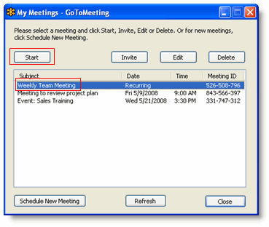
Start a scheduled meeting
To start a scheduled meeting from your desktop
1. Right-click the icon in the PC system tray. Select My Meetings.
2. Enter the same Email and Password used to schedule the meeting. (Check PID notes or calendar details.
Click Log In.
3. On the My Meetings window, select the meeting you want to start in
Subject column. Click the Start button.
Your meeting will start and the GoToMeeting Organizer Control Panel will appear on the right side
of your desktop.
Notes:
6

Slide 7
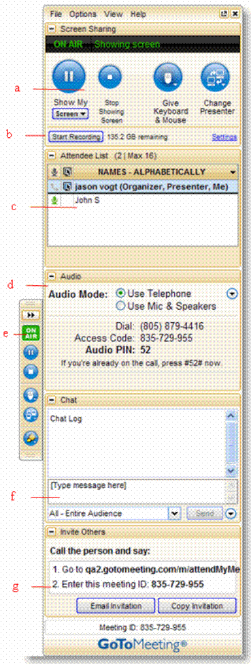
Organizer Control Panel
• The Screen Sharing pane provides presenters with On Air status, ablity to show their screens, pause showing their screens, pass keyboard control and change presenters. (a)
• Recording Section (b) is not available for our account.
• The Attendee List pane provides organizers with a list of all meeting attendees and enables them to make other attendees the presenter, grant or revoke
attendee privileges and dismiss attendees. (c)
• The Audio pane provides access to the audio
settings for organizers/presenters and attendees.
(d)
• The Grab Tab enables organizers/presenters to
minimize the Control Panel to the side of their
desktops to display their full desktops to attendees
and still access Presenter Screen Tools. (e)
• The Chat pane allows organizers and attendees to
communicate privately or publicly. (f)
• The Invite Others pane, which includes the meeting URL and ID, provides a handy way to invite more attendees. (g)
Notes:
7

Slide 8
Tips for Success
Choose a screen from the Show My Screen menu to greet your attendees as they arrive.
Arrive a few minutes early to greet the attendees. Your presence in these opening minutes can help establish the tone and direction of the meeting.
Provide an agenda at the start of the meeting, including estimated duration, and stick to it.
Inform attendees that the call is being recorded, purpose/goal of the meeting is, provide a statement of reassurance, and when and how to ask questions and participate in the meeting.
If needed, nominate a co-organizer to monitor and respond to the chat log when someone is presenting.
Encourage participation by using open questions such as “What would you suggest?” and “How do you feel about?”
End the meeting clearly. Make sure all the attendees know that the meeting is formally over and stay on the line to address any last questions.
Notes:
8

Slide 9
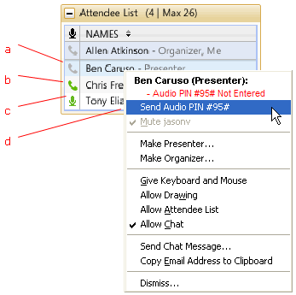
Audio PIN
Audio PIN
Everyone who joins a meeting is provided a unique Audio PIN that, when entered, gives an organizer
muting and unmuting control. Those joining by VoIP automatically have the Audio PIN assigned to them.
Those joining by telephone are prompted to enter their Audio PIN when they first dial in. An Audio PIN can be entered on the telephone at anytime during the meeting by entering the # key, then the Audio PIN, followed by the # key a second time.
Attendees Audio
• This example shows that the presenter joined via telephone but did not enter his or her Audio PIN and is currently unmuted. (a)
• This attendee joined via telephone and is unmuted. (b) •
This attendee joined via VoIP and is unmuted. (c)
• Attendees who join the meeting via
telephone must enter their Audio PIN
so that you have full audio controls
through the Organizer Control Panel.
If not entered, you can right-click the
person’s name and select Send Audio
PIN. This will send a pop-up message
with the Audio PIN to that person. (d)
Notes:
9

